Slide 1

INTEGRATED CARE AND ITs SOLUTIONS AS A TOOL FOR CONTINUITY OF CARE AND PATIENT SAFETY.
Dorota Kilańska RN, PhD
European Nursing Research Foundation (ENRF)
Medical University of Lodz (MUL)

Slide 2
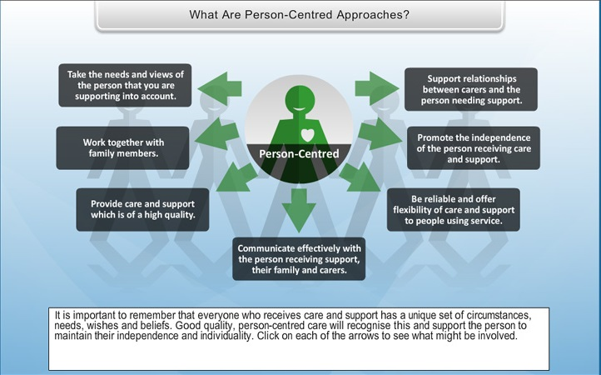
Integrated Care & Person Centred Care

Slide 3
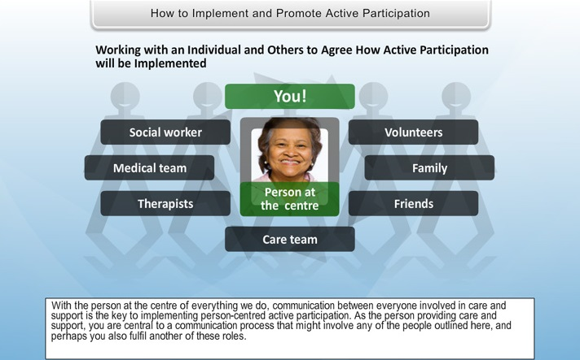
Integrated Care & Person Centred Care

Slide 4
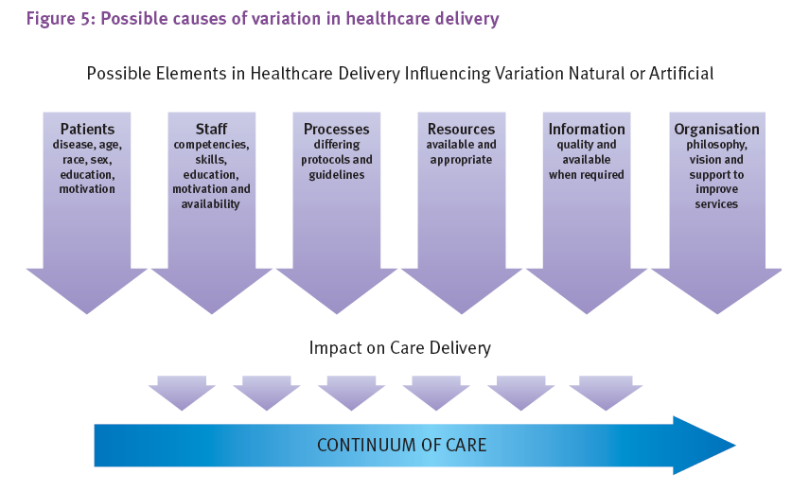


NCNM 2006

Slide 5




Patient Safety
The Council Recommendation on patient safety (Council of the EU, 2009) defines ‘patient safety’ as freedom, for the patient, from unnecessary harm or potential harm associated with healthcare.
Notes:
It suggests embedding patient safety education in the CPD programmes of healthcare professionals and collaboration with those organisations providing professional education in healthcare to ensure patient safety is a core part of ongoing health care professionals’ education and training.

Slide 6
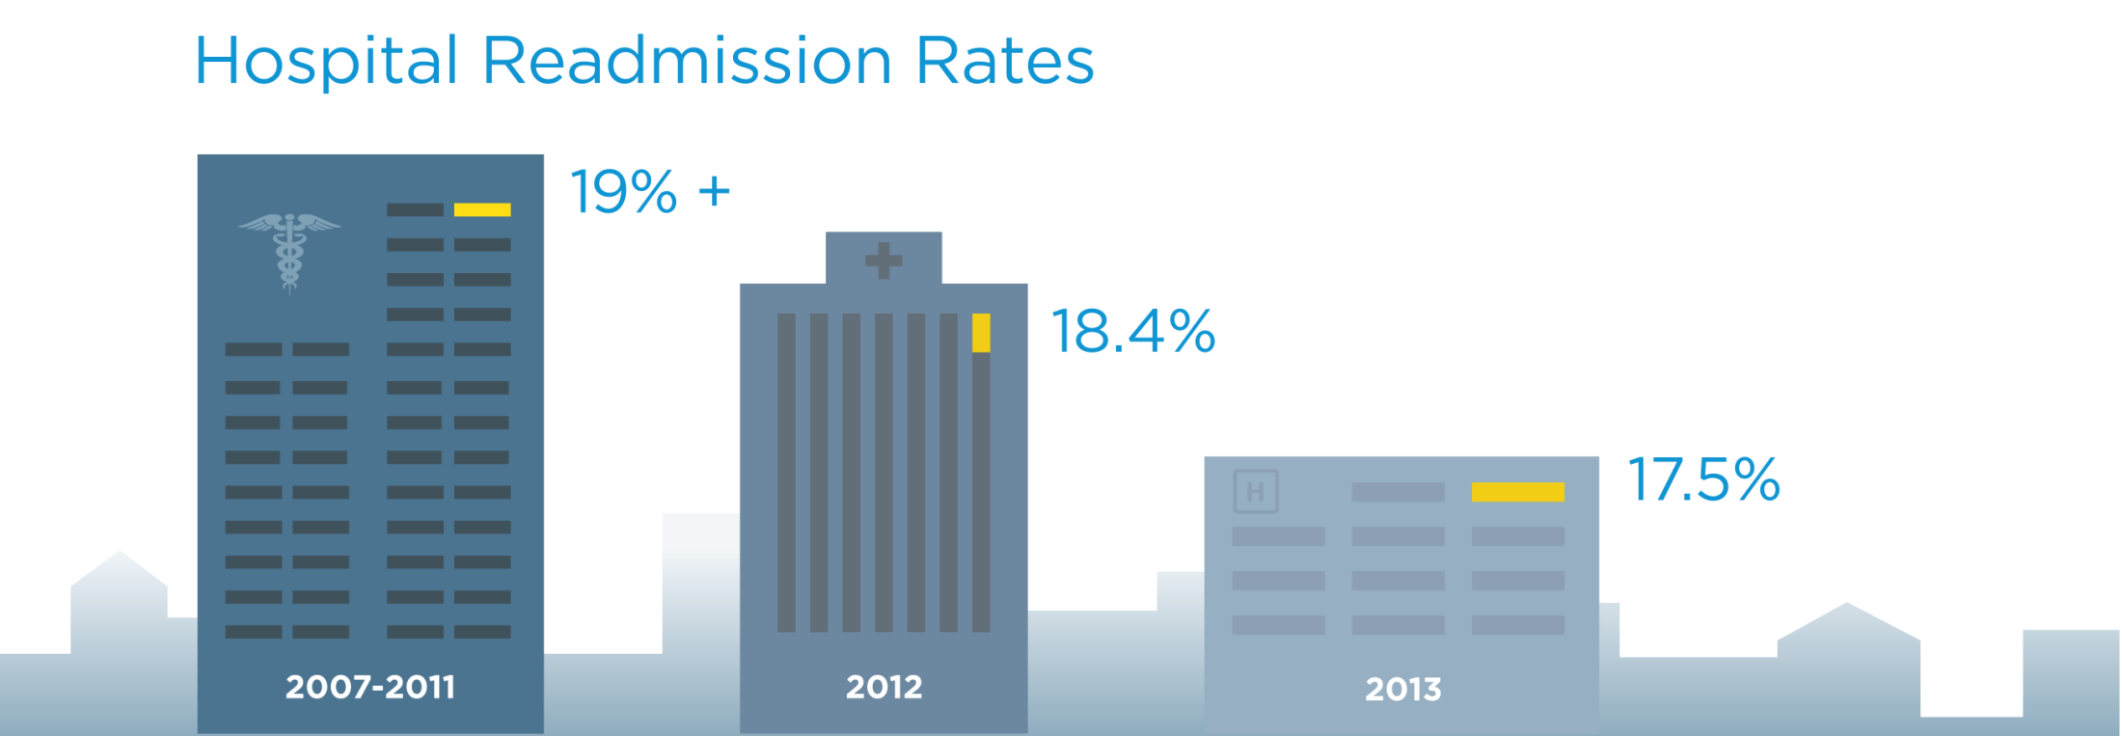
Integrated Care
&
Hospital Readmission Rates

Slide 7
Evidence Based Guidelines for Nursing and Social Care on eHealth Services
Thematic Network
CIP-ICT-PSP 7 – 2013
European Federation of Nurses Associations
The Nurses’ Voice

Slide 8
The objective
The main objective of the project is the development of evidence based guidelines for the implementation of eHealth services in nursing and social care, building on existing good practices amongst the participants of the Network, sharing and transferring knowledge across the European Economic Area. The ultimate goal of ENS4Care is the establishment of a sustainable mechanism to support nursing and social care research in the field of ICT enabled integrated care.

Slide 9
The mission
ENS4Care is a Thematic Network gathering together 24 partners from all over Europe. Its overriding objective is to share good social work and nursing practices in eHealth services and through evaluation and conscensus building, create a set of guidelines on healthy lifestyle and prevention, early intervention and clinical practice , integrated care and skills development for advanced roles such as nurse and social prescribing.

Slide 10
Policy-makers in Europe recognise that increased use of ICT in the health and social care sectors can help solve many of the challenges.
Safe and high-quality care is inextricably linked with the development and implementation of eHealth services.
Innovative, high quality, safe and cost-effective national healthcare systems are dependent upon policy-makers and stakeholders developing and implementing high-quality eHealth services.

Slide 11
Integrated Care is a concept bringing together inputs, delivery, management and organization of services related to diagnosis, treatment, care, rehabilitation and health promotion, integration is a means to improve services in relation to access, quality, user satisfaction and efficiency (WHO).
The ultimate goal of ENS4Care is the establishment of a sustainable mechanism to support nursing and social care research in the field of ICT enabled integrated care.

Slide 12
Data collection overview
Over 100 submissions made

Slide 13
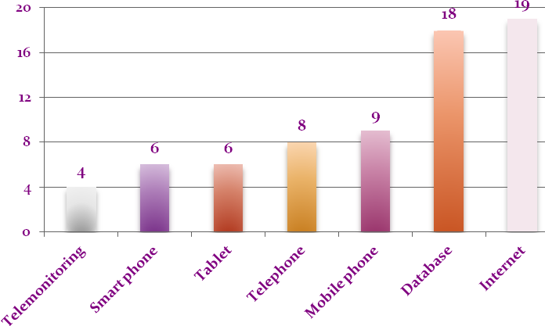
The list of equipment used to provide e-services, the results of ENS4Care Project

Slide 14
Current status of development
Response | Percentage | Count
Fully Implemented | 53% | 11
Pilot | 19% | 4
Demonstrator | 14% | 3
No response | 14% | 3

Slide 15
Current status of development

Slide 16
Geographical coverage
Response | Percentage | Count
European | 5% | 1
National | 19% | 4
Regional | 24% | 5
Local | 52% | 11

Slide 17
Geographical coverage

Slide 18
Does the practice involve sharing of clinical information
Response | Percentage | Count
NO | 38% | 8
YES | 57% | 12
No response | 5% | 1

Slide 19
Does the practice involve sharing of clinical information

Slide 20
The practice based on a dataset
Response | Percentage | Count
NO | 33% | 7
YES | 62% | 13
No response | 5% | 1

Slide 21
The practice based on a dataset

Slide 22
Requirements and implications

Slide 23
The practice changed the relationship between departments
Response | Percentage | Count
NO | 19% | 4
YES | 76% | 16
No response | 5% | 1

Slide 24
The practice changed the relationship between departments

Slide 25
The practice changed the roles and/or responsibilities of professionals
Response | Percentage | Count
NO | 43% | 9
YES | 52% | 11
No response | 5% | 1

Slide 26
The practice changed the roles and/or responsibilities of professionals

Slide 27
The practice involve sharing of clinical information
Response | Percentage | Count
NO | 38% | 8
YES | 57% | 12
No response | 5% | 1

Slide 28
The practice involve sharing of clinical information

Slide 29
The health/social care professionals provided with specific education
Response | Percentage | Count
NO | 19% | 4
YES | 81% | 17
No response | -- | --

Slide 30
European integration and policyThe practice been part of a European Commission funded project
Response | Percentage | Count
NO | 86% | 18
YES | 5% | 1
I don’t know/ No response | 10% | 2

Slide 31
European integration and policy
The practice been part of a European Commission funded project

Slide 32
European integration and policy
Is there a local/regional/national eHealth strategy framework in place:
Response | Percentage | Count
NO | 29% | 6
YES | 62% | 13
No response | 10% | 2

Slide 33
Conclusion
There is a prominent role for ICT in supporting the reorganisation of health services towards integrated care and building interoperability for patient safety.
It is important to remember that introducing telehealth and telecare to clinical practice is not about replacing existing services, but instead using technology to enhance, improve access, triage and offer a wider range of choice in the services provided for patient care.

Slide 34
Conclusion
ENS4Care sees technology as a support for the needed variation in the way health and social work is organised and delivered in the hope to more effectively address health inequalities.

Slide 35
Conclusion
Implementation of eHealth services for clinical practice holds great potential for improving the quality and safety of care for citizens across the EU through ensuring continuity of health care across primary and secondary community sectors.
This may yield substantial benefits for citizens and health professionals.

Slide 36
Guideline statements
eHealth solutions should be considered for any health issue that requires an element of collaboration between primary and secondary health and social care providers.
All countries should have a common database-based network solution that can help with the coordination and communication between primary and secondary care providers, including nurses and social workers.
ENS4Care General Assembly Brussels, 15 April 2015

Slide 37
Guideline statements
Documentation should use the international standards of reference terminology model, which is recommended by the World Health Organisation
Consideration should be given to establishing a single point of contact for staff support i.e. a kind of a ‘super-user’, who can respond to issues, troubleshoot and offer advice.
ENS4Care General Assembly Brussels, 15 April 2015

Slide 38
Recommendations
eHealth should not be viewed as a substitute for the face to face contact with professionals that citizens require at times of crisis or during acute phases of their illness, but it has the potential to radically enhance the exchange of information between service users and those concerned with their treatment and support and ensure that new or changing requirements are speedily addressed.

Slide 39

PARTNERS

